Slide 1

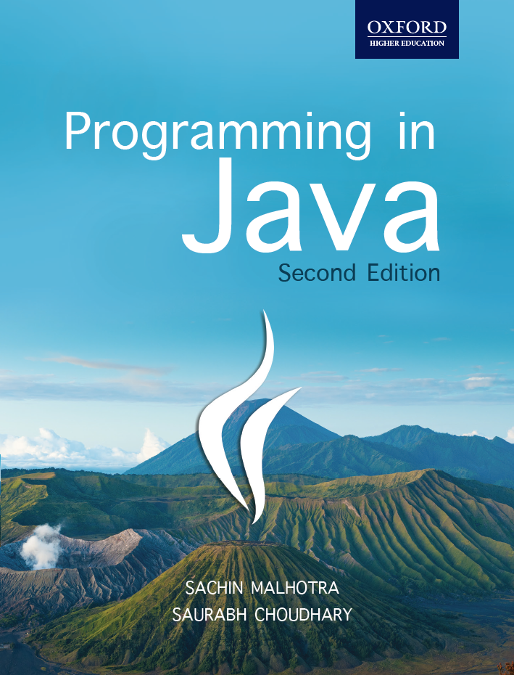
Programming in Java, 2e
Sachin Malhotra
Saurabh Choudhary

Slide 2
Chapter 5
Inheritance

Slide 3
Objectives
Know the difference between Inheritance and aggregation
Understand how inheritance is done in Java
Learn polymorphism through Method Overriding
Learn the keywords : super and final
Understand the basics of abstract class.

Slide 4
Inheritance
Is the ability to derive something specific from something generic.
aids in the reuse of code.
A class can inherit the features of another class and add its own modification.
The parent class is the super class and the child class is known as the subclass.
A subclass inherits all the properties and methods of the super class.

Slide 5
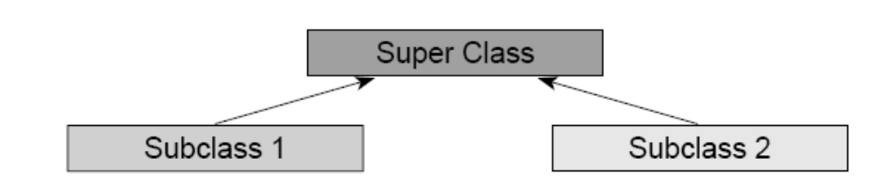
Inheritance

Slide 6
Aggregation
We can make up objects out of other objects.
The behaviour of the bigger object is defined by the behaviour of its component objects, separately and in conjunction with each other.
cars contain engine which in turn contains an ignition system and starter motor.
a whole-part relationship exists in aggregation
car being the whole and engine being its part.

Slide 7
Types of Inheritance
Single
Multiple
Multilevel
Hierarchical
Hybrid

Slide 8
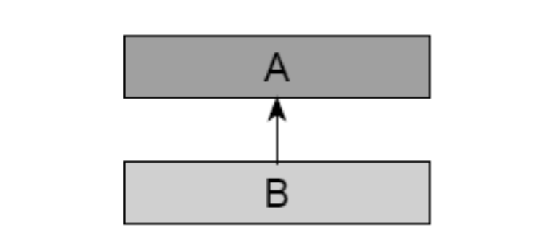
Single level inheritance
Classes have only base class

Slide 9
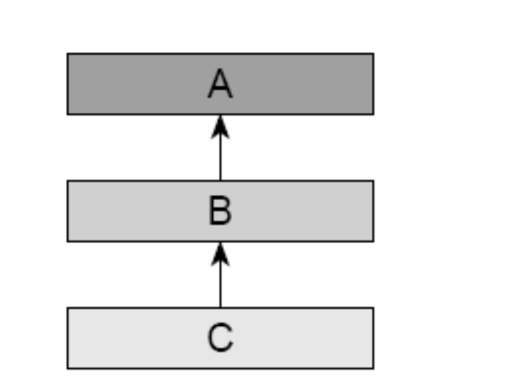
Multi level
There is no limit to this chain of inheritance (as shown below) but getting down deeper to four or five levels makes code excessively complex.

Slide 10
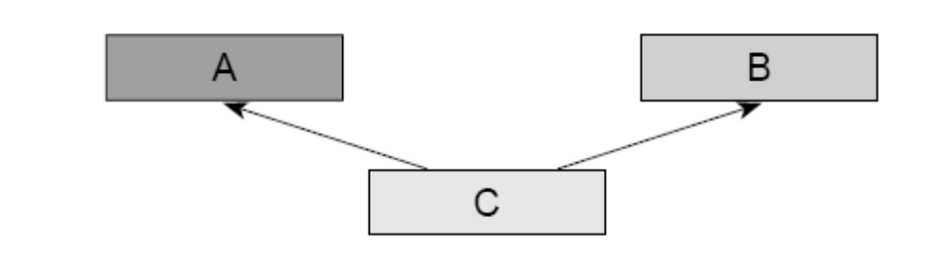
Multiple Inheritance
A class can inherit from more than one unrelated class

Slide 11
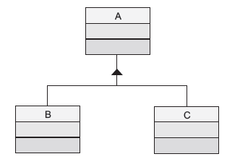
Hierarchical Inheritance
In hierarchical inheritance, more than one class can inherit from a single class. Class C inherits from both A and B.

Slide 12
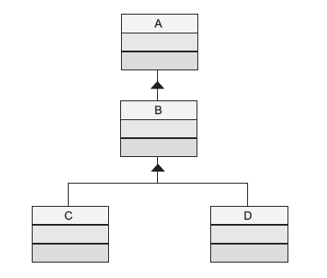
Hybrid Inheritance
is any combination of the above defined inheritances

Slide 13
Deriving Classes
Classes are inherited from other class by declaring them as a part of its definition
For e.g.
  class MySubClass extends MySuperClass
extends keyword declares that MySubClass inherits the parent class MySuperClass.

Slide 14
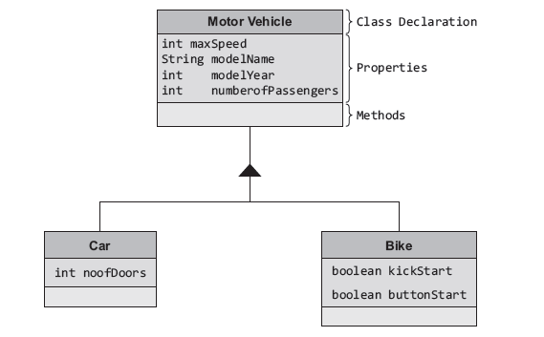
Inheritance

Slide 15
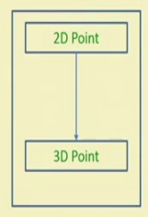

Example

Slide 16
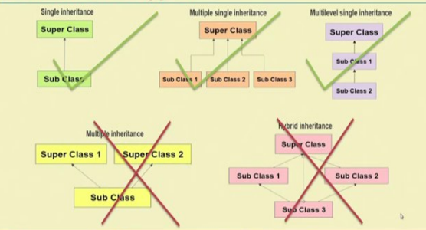

Slide 17
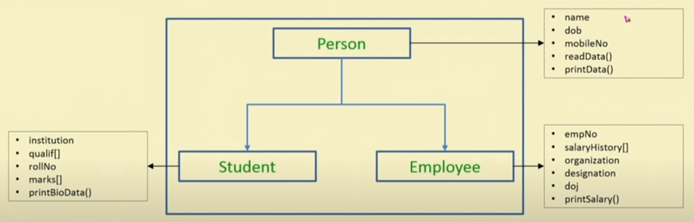

Slide 18
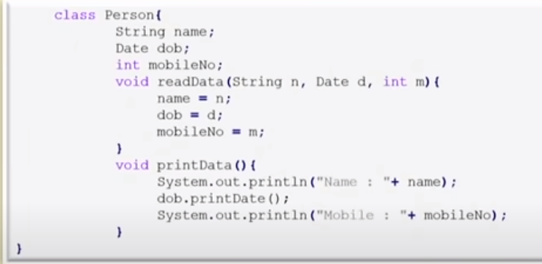
Person class

Slide 19
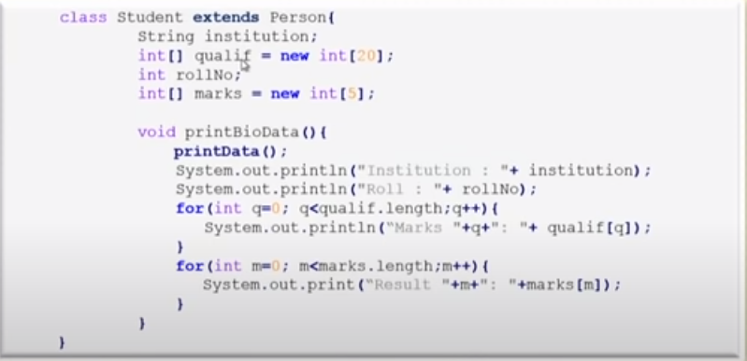
Student class

Slide 20
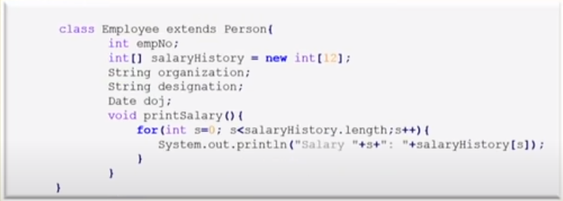
Employee class

Slide 21
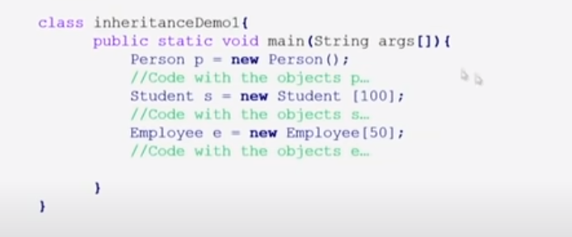
Main class

Slide 22
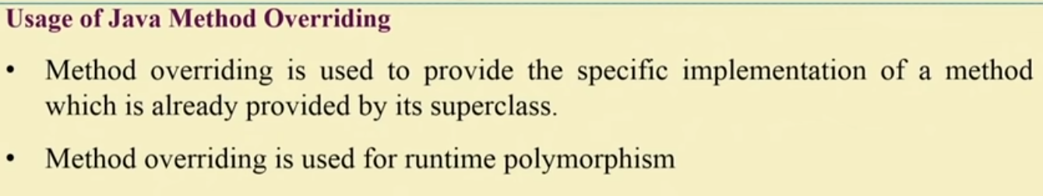
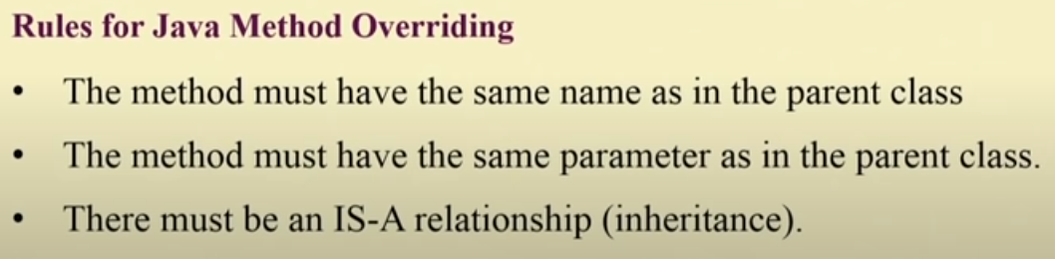
Method overriding

Slide 23
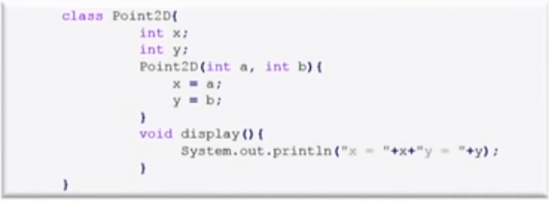
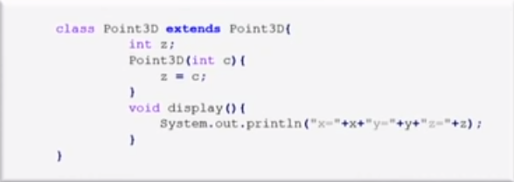
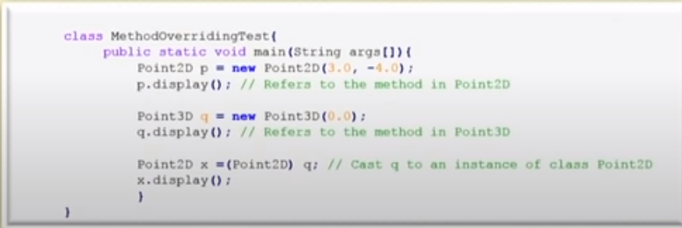

Slide 24
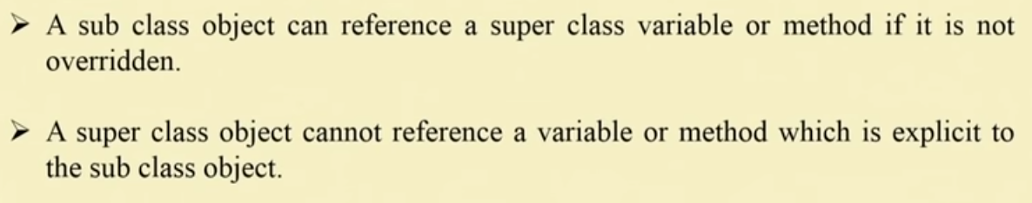

Slide 25
Method Overriding
a method in a subclass has the same name and type signature as a method in its superclass, then the method in the subclass is said to override the method in the superclass.
it is a feature that supports polymorphism.
When an overridden method is called through the subclass object, it will always refer to the version of the method defined by the subclass.
The superclass version of the method is hidden.

Slide 26
Method Overriding Example
class A {
int i = 0;
void doOverride (int k) {
i = k; } }
class B extends A {
void doOverride(int k) {
i = 2 * k;
System.out.println(“The value of i is: “+i); }
public static void main (String args[])
{ B b = new B();
b.doOverride(12);
}}

Slide 27
The output
The value of i is: 24

Slide 28
Late binding Vs Early binding
Binding is connecting a method call to a method body.
When binding is performed before the program is executed, it is called early binding.
If binding is delayed till runtime it is late binding.
also known as dynamic binding or runtime binding.
All the methods in Java use late binding (except static and final).

Slide 29
Superclass Can Refer to a Subclass Object
class SuperClass {
int instanceVariable = 10;
static int classVariable = 20;}
class SubClass extends SuperClass{
int instanceVariable = 12;
static int classVariable = 25;
public static void main(String args[]) {
SuperClass s=new SubClass();

Slide 30
Superclass Can Refer to a Subclass Object
System.out.println("Superclass Instance variable: "+s.instanceVariable);
System.out.println("Superclass static variable: "+s.classVariable);
SubClass st=new SubClass();
System.out.println("Subclass Instance variable: "+st.instanceVariable);
System.out.println("Subclass static variable: "+st.classVariable); } }

Slide 31
The Output
Superclass Instance variable: 10
Superclass static variable: 20
Subclass Instance variable: 12
Subclass static variable: 25

Slide 32
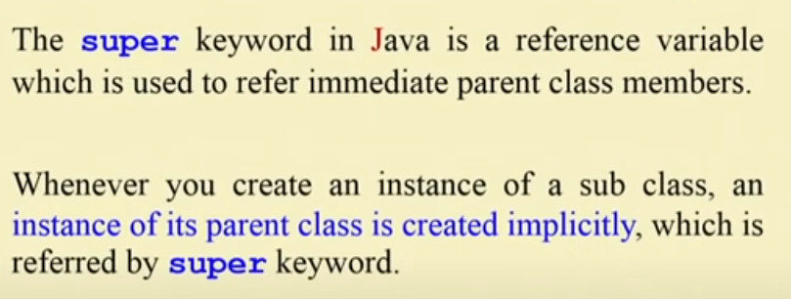
Super Keyword

Slide 33
super Keyword
For invoking the methods of the super class.
For accessing the member variables of the super class.
For invoking the constructors of the super class.

Slide 34
super Keyword (contd.)
class A {
void show()
{ System.out.println(“Super Class show method”);
} }
class B extends A
void show()
{ System.out.println(“Subclass show method”); }
public static void main (String args[ ]) {
A s1=new A();
s1.show();
B s2=new B ();
s2.show();
}}

Slide 35
Problem and Solution
Two methods being called by two different objects (inherited), instead the job can be done by one object only, i.e. using super keyword.

Slide 36
Case 1: Invoking Methods using super
class ANew {
void show()
{ System.out.println(“Super Class show method”); } }
class BNew extends ANew {
void show()
{
super.show();
System.out.println(“Subclass show method”);
}
public static void main (String args[ ]) {
BNew s2=new BNew ();
s2.show(); }}

Slide 37
Case 2: Accessing variables using super
class Super_Variable {
int b=30; }
class SuperClass extends Super_Variable {
int b=12;
void show() {
System.out.println(“subclass class variable: “+ b);
System.out.println(“superclass instance variable: “+ super.b);
}
public static void main (String args[]) {
SuperClass s=new SubClass();
s.show(); // call to show method of Sub Class B
}}

Slide 38
The output
subclass class variable: 12
superclass instance variable: 30

Slide 39
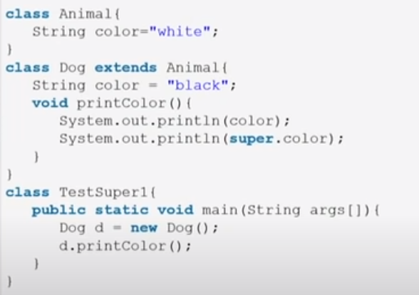
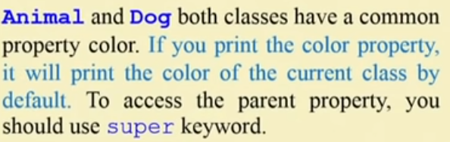
Referring parent class instance value

Slide 40
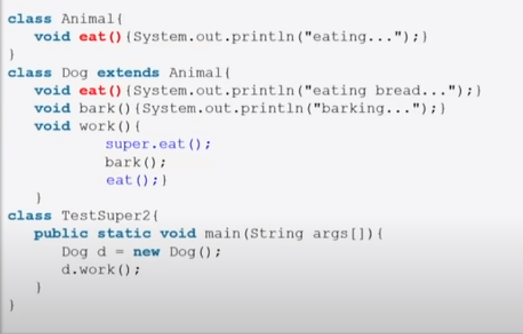
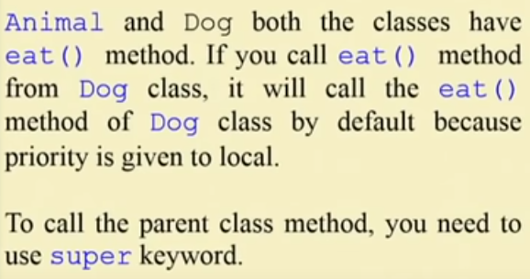
Invoking parent class method

Slide 41
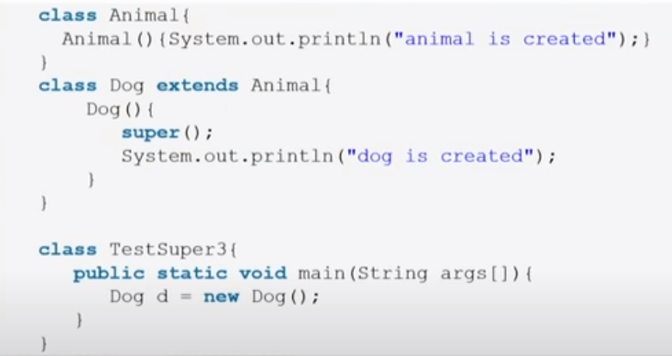
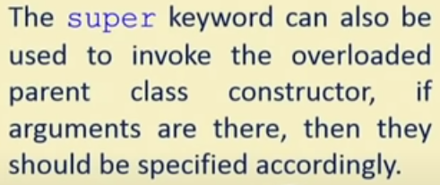
Invoking parent class constructor

Slide 42
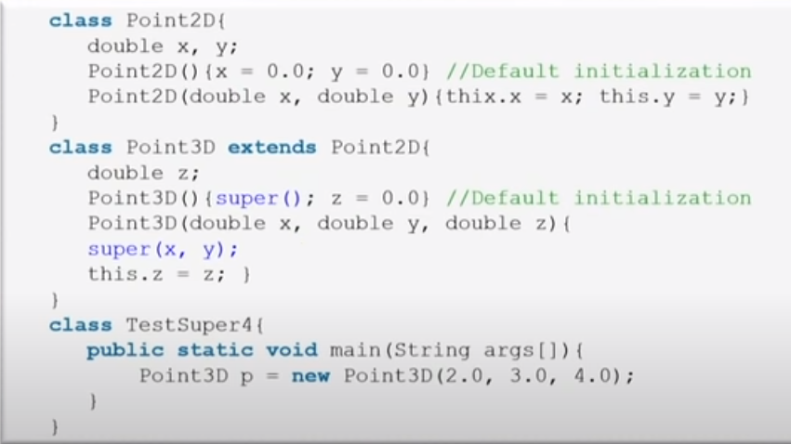
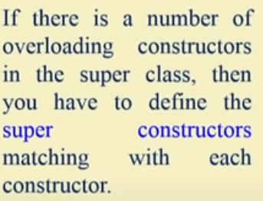

Slide 43
Case 3: constructors of the super class.
class Constructor_A {
Constructor_A() {
System.out.println(“Constructor A”); }}
class Constructor_B extends Constructor_A {
Constructor_B() {
System.out.println(“Constructor B”); }}
class Constructor_C extends Constructor_B {
Constructor_C() {
System.out.println(“Constructor C”); }
public static void main (String args[]) {
Constructor_C a=new Constructor_C();
}}

Slide 44
Case 3: (contd.)
class Constructor_A_Revised {
Constructor_A_Revised()
{
System.out.println(“Constructor A Revised”);
}}
class Constructor_B_Revised extends Constructor_A_Revised {
/*Constructor_B_Revised()
{
System.out.println(“Constructor B”);
}*/
Constructor_B_Revised(int a) {
a++;
System.out.println(“Constructor B Revised “+ a ); }}
class Constructor_C_Revised extends Constructor_B_Revised {
Constructor_C_Revised() {
super(11); // if omitted compile time error results
System.out.println(“Constructor C Revised”); }
public static void main (String args[]) {
Constructor_C_Revised a=new Constructor_C_Revised();
}}

Slide 45
The Output
Constructor A
Constructor B
Constructor C

Slide 46
The Output
Constructor A Revised
Constructor B Revised 12
Constructor C Revised

Slide 47
final keyword
Declaring constants (used with variable and argument declaration)
  final int MAX=100;
Disallowing method overriding (used with method declaration)
  final void show (final int x)
Disallowing inheritance (used with class declaration).
  final class Demo {}

Slide 48
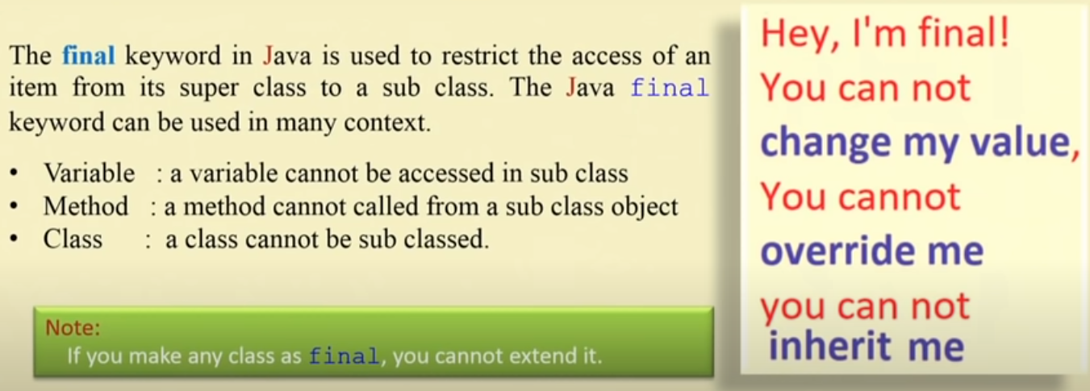

Slide 49
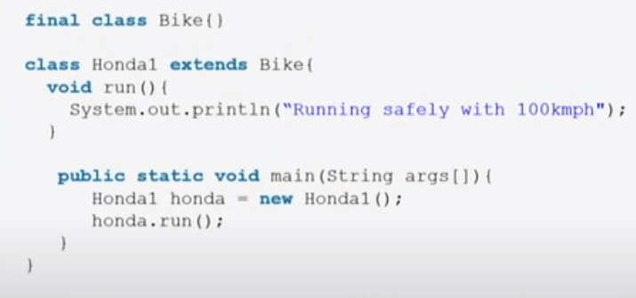
Example

Slide 50
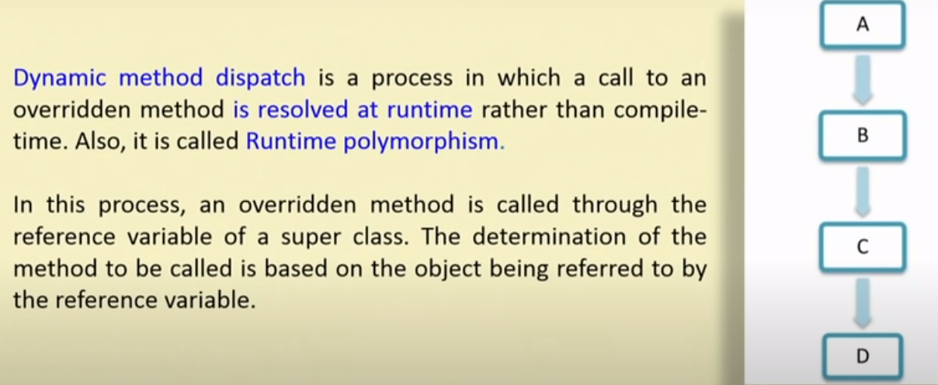
Dynamic method dispatch concept

Slide 51
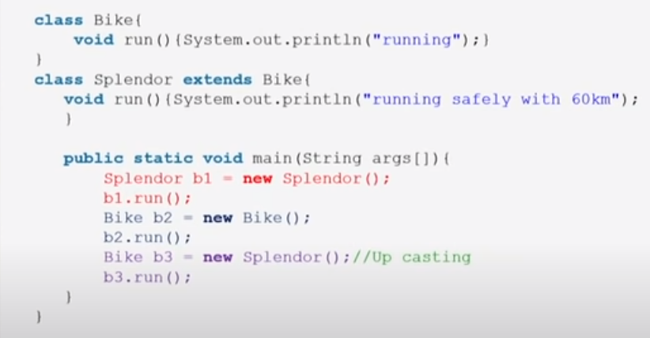
Example

Slide 52
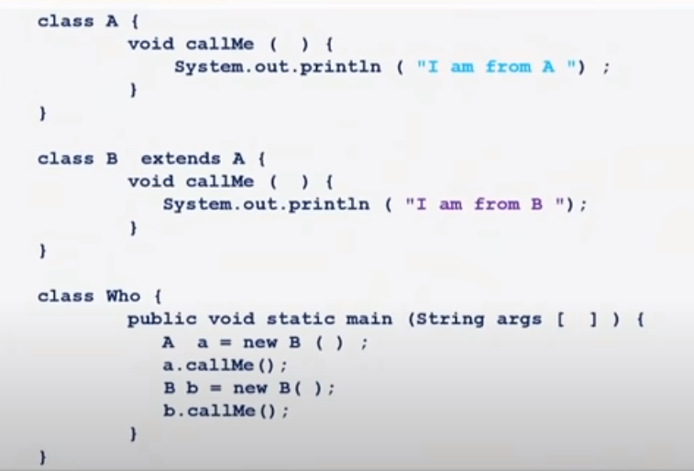
Example

Slide 53
Your Turn
What is method overriding?
Highlight the usage of super keyword?
What are the usages of final keyword?
What is late binding and early binding?

Slide 54
Abstract class
Abstract classes are classes with a generic concept, not related to a specific class.
Abstract classes define partial behaviour and leave the rest for the subclasses to provide.
contain one or more abstract methods.
abstract method contains no implementation, i.e. no body.
Abstract classes cannot be instantiated, but they can have reference variable.
If the subclasses does not override the abstract methods of the abstract class, then it is mandatory for the subclasses to tag itself as abstract.

Slide 55
Why create abstract methods?
to force same name and signature pattern in all the subclasses
subclasses should not use their own naming patterns
They should have the flexibility to code these methods with their own specific requirements.

Slide 56
Example of Abstract class
abstract class Animal
{
String name;
String species;
Animal(String n, String s)
{
name=n;
species=s;
}
void eat(String fooditem)
{
System.out.println(species +” “+ name + “likes to have “+ fooditem);
}
abstract void sound();
}

Slide 57
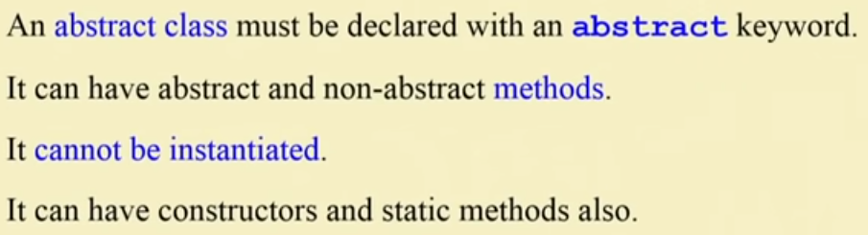

Slide 58
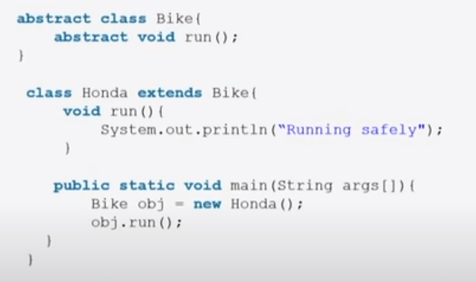
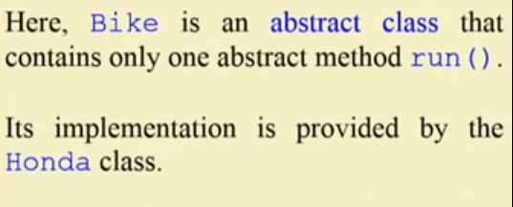
Example

Slide 59
Shadowing Vs Overriding
Shadowing of fields
  occurs when variable names are same. It may occur when local variables and instance variable names collide within a class or variable names in superclass and subclass are same.
In case of methods,
  instance methods are overridden whereas static methods are shadowed. The difference between the two is important because shadowed methods are bound early whereas instance methods are dynamically (late) bound.

Slide 60
Shadowing Vs Overriding
class Shadowing{
static void display(){
System.out.println("In Static Method of Superclass");
}
void instanceMethod() {
System.out.println("In instance Method of Super Class");
}}

Slide 61
Shadowing Vs Overriding
class ShadowingTest extends Shadowing {
static void display(){
System.out.println("In Static Method of Sub Class");
}
void instanceMethod() {
System.out.println("The Overridden instance Method in Sub Class");
}

Slide 62
Shadowing Vs Overriding
public static void main(String args[]){
Shadowing s=new ShadowingTest();
s.display();
s.instanceMethod();
ShadowingTest st=new ShadowingTest();
st.display();
st.instanceMethod();
} }

Slide 63
The Output
In Static Method of Superclass
The Overridden instance Method in Subclass
In Static Method of Subclass
The Overridden instance Method in Subclass

Slide 64
Practical Problem: Circle class
class Circle {
float radius;
final fl oat PI = 3.141f; //value of pi is fi xed
Circle(){
radius = 1.0f;}
Circle(fl oat radius) {
this.radius = radius;}
float getArea() {
return PI * radius * radius; }}

Slide 65
Practical problem: Cylinder class
class Cylinder extends Circle {
float height;
Cylinder(fl oat radius, fl oat height){
super(radius);
this.height = height;
}
float getArea() {
return 2 * super.getArea() + 2 * PI * radius * height; }

Slide 66
Practical problem
public static void main(String args[]) {
Circle c = new Circle(1.5f);
System.out.println("The Area of Circle is: " + c.getArea());
Cylinder cy = new Cylinder(1.5f,3.5f);
System.out.println("The Surface Area of Cylinder is: " + cy.getArea());
}}

Slide 67
Summary
The concept of Inheritance is derived from real life.
The properties and methods of a parent class are inherited by the children or subclasses.
Subclasses can provide new implementation of method using method overriding, keeping the method names and signatures same as that of the parent class.
The super keyword can be used to access the overridden methods, variables and even the constructors of the super class.
Abstract classes are used to force the subclasses to override abstract methods and provide body and code for them.
The final keyword is used to create constants and disallow inheritance.

